Slide 1
Development of Spiropyran Immobilization and Characterization Protocols for Reversible Photo-Patterning of SiO₂ Surfaces
Bokun Zhou, Ph.D. Candidate in Materials Science
Remcho Research Group
Oregon State University
Presented on: November 28, 2023
Presentation Number: EL06.05.07

Slide 2
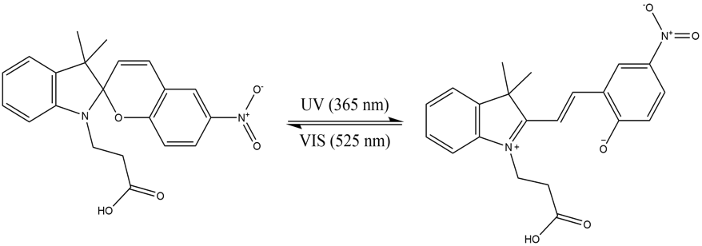
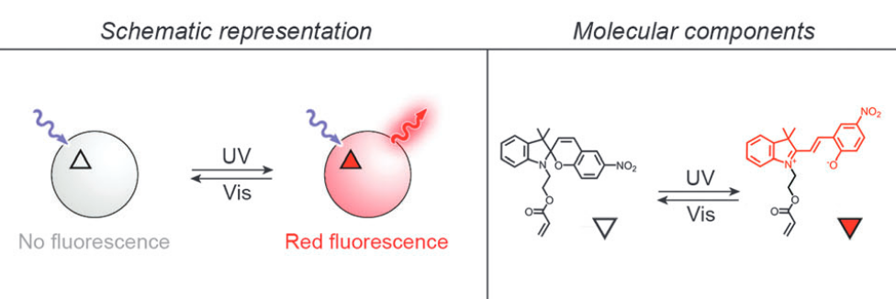
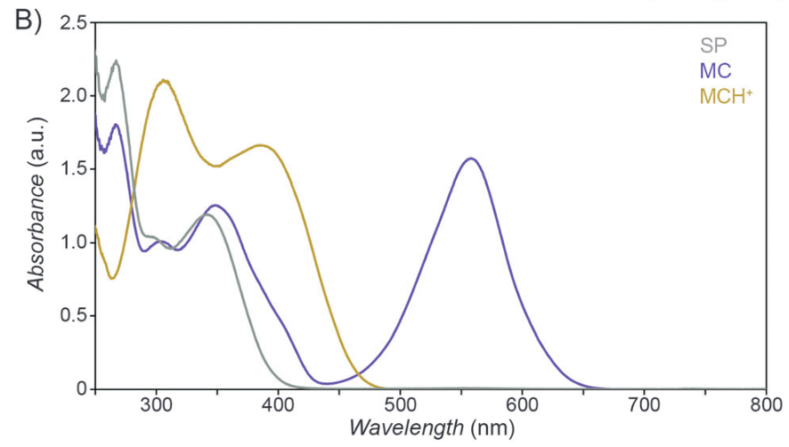
Properties of Spiropyran
Photochromism
Reversible conversion
Triggered by lights
Spiropyran (SP)
hydrophobic, colorless
closed form
Merocyanine (MC)
hydrophilic, purple
open form
MC form is fluorescent at red 630nm^{[1]}
Indole
Benzopyran
MC Absorption Peak
Sensitive to various stimuli ^{[1]}
Light
Temperature
pH
Solvent polarity
Metal ions
Redox potential
Mechanical stress
Chemical structure of a common spiropyran
UV-VIS spectra of SP, MC and protonated MC^{[1]}
Background
[1] R. Klajn, “Spiropyran-based dynamic materials,” Chem. Soc. Rev., vol. 43, no. 1, pp. 148–184, 2014, doi: 10.1039/c3cs60181a.

Slide 3
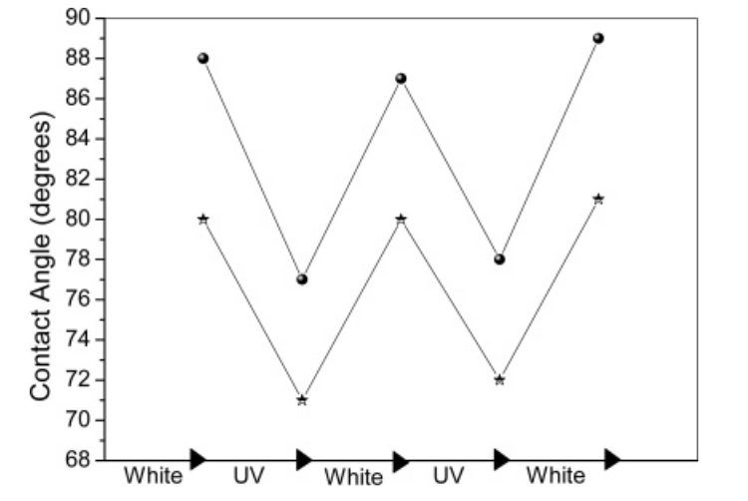
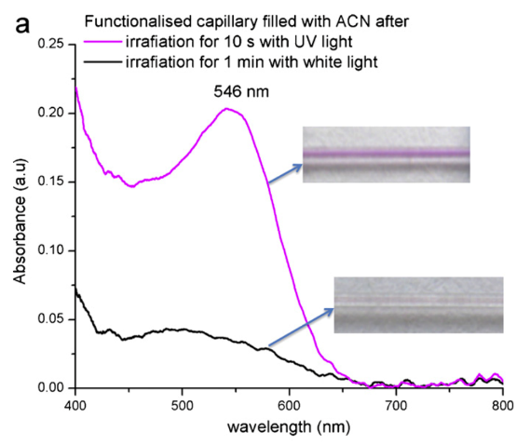
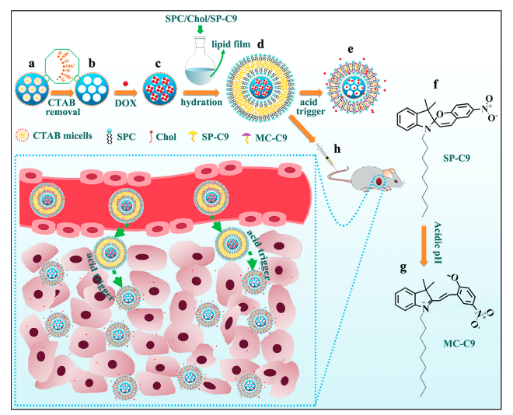
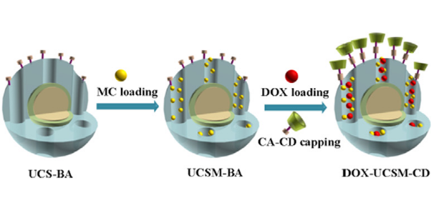
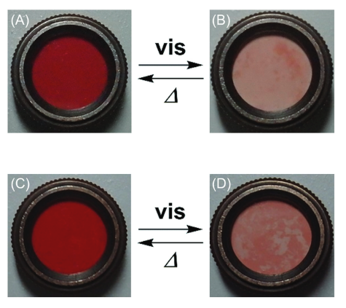
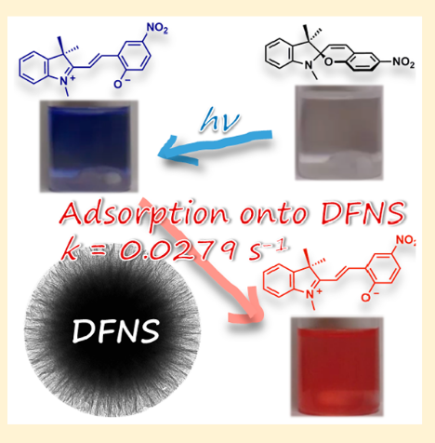
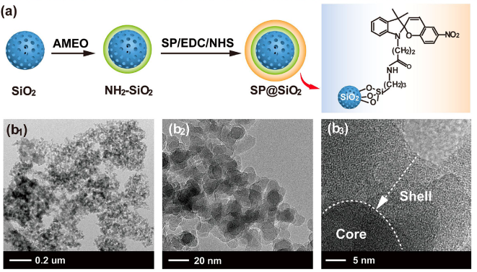
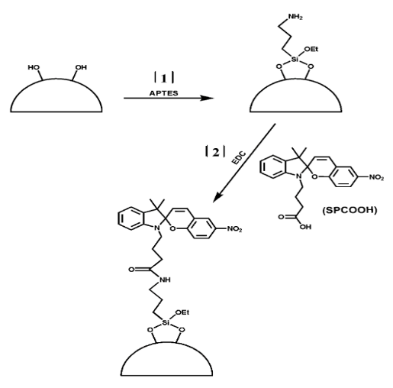
Spiropyran Applications with SiO₂
Silicon wafer
Change of contact angle^{[1]}
Silica capillary
Capillary-integrated optical sensor^{[2]}
Silica, mesoporous
Size changes (pH); drug delivery ^{[3]}
Silicon wafer
Change of contact angle^{[1]}
Silica capillary
Capillary-integrated optical sensor^{[2]}
Silica, mesoporous
Size changes (pH); drug delivery ^{[3]}
Silica, mesoporous
Ring-opening (pH); drug release ^{[4]}
Silica, mesoporous
Ring-opening (pH); drug release ^{[4]}
Silica, dendritic fibrous
Photo-induced adsorption^{[6]}
Silica, mesoporous
Pore size affect kinetics ^{[5]}
Silica, dendritic fibrous
Photo-induced adsorption^{[6]}
Silica, nanoparticle
Adsorption of fluoride contamination ^{[7]}
Silica, mesoporous
Pore size affect kinetics ^{[5]}
Silica, nanoparticle
Adsorption of fluoride contamination ^{[7]}
Silica, microbeads
Metal ion extraction ^{[8]}
Silica, microbeads
Metal ion extraction ^{[8]}
Background
Substrates and Applications

Slide 4
Spiropyran Applications with SiO₂
Thermal hydrosilylation
Porous Substrate
Aim of this work
Robust immobilization, optimized
Quick and effective characterization
Silane coupling
w.
SP polymer
Silane coupling
w.
customized SP
Porous Substrate
Silane coupling
w.
customized SP
Silicon wafer
Change of contact angle^{[1]}
Silica capillary
Capillary-integrated optical sensor^{[2]}
Silica, mesoporous
Size changes (pH); drug delivery ^{[3]}
Silica, mesoporous
Ring-opening (pH); drug release ^{[4]}
Porous Substrate
Porous Substrate
Porous Substrate
Porous Substrate
Non-covalent bonded
Silane coupling
w.
customized SP
Non-covalent bonded
Silane coupling
w.
carboxylic SP
Silica, mesoporous
Pore size affect kinetics ^{[5]}
Silica, dendritic fibrous
Photo-induced adsorption^{[6]}
Silica, nanoparticle
Adsorption of fluoride contamination ^{[7]}
Silica, microbeads
Metal ion extraction ^{[8]}
Background
Substrate Types and Bonding Methods

Slide 5
Technical Approach (this work)
-OH groups
SiO₂
SiO₂
SiO₂
SiO₂
-NH₂ terminated crosslinker
Si substrate
Si substrate
Si substrate
Si substrate
Merocyanine (MC)
Bare substrate
Activation
Amination
Functionalization
Method

Slide 6
Immobilization: effective activation and amination
Surface Atomic Concentration by XPS and Contact Angle
Activation Step
 | C 1s | O 1s | Si 2p | Contact Angle
Untreated SiO₂ Surface | 2.8% | 67.1% | 30.1% | 60°– 70°
Activated with O₂ plasma | 3.8% | 67.5% | 28.8% | 10°– 15°
Activated with HCl | 2.8% | 67.6% | 29.6% | 10°– 15°
Activated with H₂SO₄ | 2.7% | 67.6% | 29.7% | 10°– 15°
Selected Activation Methods
Oxygen plasma treatment
Acid treatment (1M HCl)
Piranha solution: (H₂SO₄ + H₂O₂)
C₉H₂₃NO₃Si
Surface Atomic Concentration Table by XPS
Amination Step
C₉H₂₃NO₃Si
Amination Process Condition | C 1s | O 1s | Si 2p | N 1s | % organosilicon* | N : % organosilicon
2% APTES 5min@RT | 22.4% | 50.7% | 24.1% | 2.8% | 2.7% | 1.0
2% APTES 10min@RT | 40% | 36.9% | 18.0% | 5.1% | 4.7% | 1.1
^{*: from the immobilized APTES}
Results

Slide 7
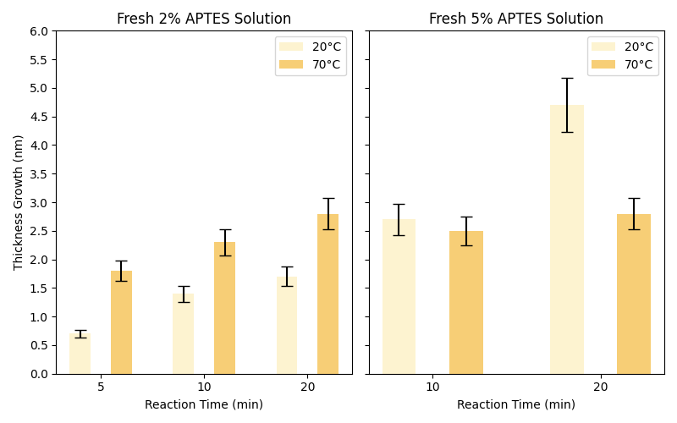
Immobilization: thin layer of APTES amination
Incubation with APTES
Reaction Time
Reaction Temperature
APTES Concentration
Thin layer, ideally mono-layer
Incident light
Reflected light
APTES
$Δ$Thickness
To reduce self-reaction
Freshly prepared APTES solution
2% APTES at room temperature for 5min → 0.5 – 0.7 nm
From XPS results, N:% organosilicon is approximately 1:1.
Together, the results verifies a successful thin layer amination.
SiO₂
Si substrate
Ellipsometry Model
Results

Slide 8
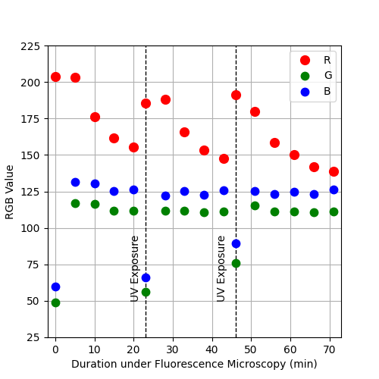
Immobilization: functionalized surface with fluorescence
Incubation with SP-COOH and EDC
EDC-mediated coupling of carboxylic acids and amines
Extracting RGB value from fluorescence images, taken at setting of 20x, 20ms
20x, 1s
20x, 10ms
20x, 10ms
MC
SP
MC
SP
Ex.
550nm
Em.
640nm
No emission with SP form
MC-immobilized SiO₂ sample
MC-immobilized glass microfiber sample
SiO₂
SiO₂
SiO₂
Si substrate
Si substrate
Results
1-(3-Dimethylaminopropyl)-3-ethylcarbodiimide hydrochloride (EDC)

Slide 9
Summary and Future Work
Immobilization Protocol
Effective activation
Thin layer amination
Fluorescence functionalization
Characterization Protocol: XPS, contact angle, ellipsometry, fluorescence
Change in surface chemistry / surface energy
Controlled thickness growth
Reversible photo-patterning and fluorescence
Surface density of functional groups
-OH is limited by surface type
On average, there are 4.9 #/nm² OH groups on amorphous silica.^{[1]}
Sensitivity of fluorescence detection
Measurement setup
MC-SP conversation
Low quantum yield of MC fluorescence
Proposed Scheme to Further Modify Surfaces
(lock in MC form & enhance fluorescence)
2-Naphthoyl chloride
Ex/Em = 265nm/380nm
Discussion
[1] L. T. Zhuravlev, “Concentration of hydroxyl groups on the surface of amorphous silicas,” Langmuir, vol. 3, no. 3, pp. 316–318, May 1987, doi: 10.1021/la00075a004.

Slide 10
References
Review Paper
[1] R. Klajn, “Spiropyran-based dynamic materials,” Chem. Soc. Rev., vol. 43, no. 1, pp. 148–184, 2014, doi: 10.1039/c3cs60181a.
Spiropyran Application with SiO₂ Surface
[1] D. Dattilo, L. Armelao, G. Fois, G. Mistura, and M. Maggini, “Wetting Properties of Flat and Porous Silicon Surfaces Coated with a Spiropyran,” p. 6, 2007, doi: 10.1021/la7024878.
[2] L. Florea, A. Hennart, D. Diamond, and F. Benito-Lopez, “Synthesis and characterisation of spiropyran-polymer brushes in micro-capillaries: Towards an integrated optical sensor for continuous flow analysis,” Sensors and Actuators B: Chemical, vol. 175, pp. 92–99, Dec. 2012, doi: 10.1016/j.snb.2011.12.055.
[3] Y. He et al., “pH-Responsive size-shrinkable mesoporous silica-based nanocarriers for improving tumor penetration and therapeutic efficacy,” Nanoscale, vol. 14, no. 4, pp. 1271–1284, 2022, doi: 10.1039/D1NR07513F.
[4] R. Han, S. Wu, K. Tang, and Y. Hou, “Facilitating drug release in mesoporous silica coated upconversion nanoparticles by photoacid assistance upon near-infrared irradiation,” Advanced Powder Technology, vol. 31, no. 9, pp. 3860–3866, Sep. 2020, doi: 10.1016/j.apt.2020.07.025.
[5] T. Yamaguchi, N. N. Leelaphattharaphan, H. Shin, and M. Ogawa, “Acceleration of photochromism and negative photochromism by the interactions with mesoporous silicas,” Photochem Photobiol Sci, vol. 18, no. 7, pp. 1742–1749, Jul. 2019, doi: 10.1039/c9pp00081j.
[6] T. Yamaguchi, A. Maity, V. Polshettiwar, and M. Ogawa, “Photochromism of a Spiropyran in the Presence of a Dendritic Fibrous Nanosilica; Simultaneous Photochemical Reaction and Adsorption,” J. Phys. Chem. A, vol. 121, no. 42, pp. 8080–8085, Oct. 2017, doi: 10.1021/acs.jpca.7b08466.
[7] X. Guan, M. He, J. Chang, Z. Wang, Z. Chen, and H. Fan, “Photo-controllability of fluoride remediation by spiropyran-functionalized mesoporous silica powder,” Journal of Environmental Chemical Engineering, vol. 9, no. 1, p. 104655, Feb. 2021, doi: 10.1016/j.jece.2020.104655.
[8] S. Scarmagnani et al., “Photoreversible ion-binding using spiropyran modified silica microbeads,” IJNM, vol. 5, no. 1/2, p. 38, 2010, doi: 10.1504/ijnm.2010.029921.
Limitation on –OH Surface Density
[1] L. T. Zhuravlev, “Concentration of hydroxyl groups on the surface of amorphous silicas,” Langmuir, vol. 3, no. 3, pp. 316–318, May 1987, doi: 10.1021/la00075a004.
Reference

Slide 14
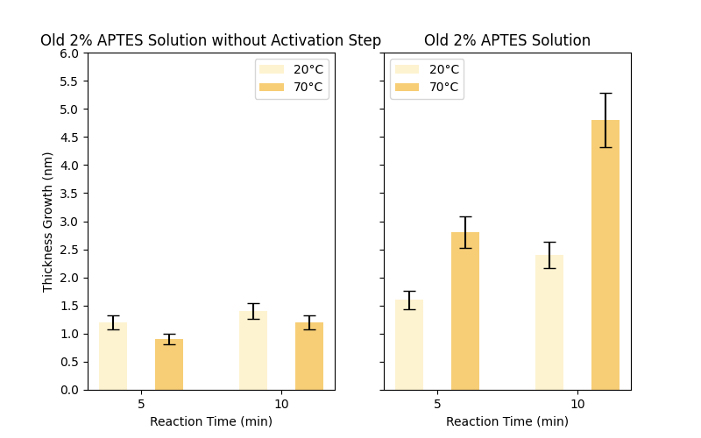
20x, 20ms
MC
SP
$$R_{MC}=170$$
$$R_{SP}=110$$
MC-immobilized PMMA sample
PMMA

Slide 15
Process and Characterization Flowchart: SiO₂ Surface
Substrate pretreat
Amination
Modification
start
SiO₂ substrate
1”x1” coupon
APTES Solution
Prepare stock solution 2% APTES in ethanol
UV irradiation
Use UV light to gate the spiropyran in MC form
APTES
amination
Immerse coupon into 2% APTES solution at room temperature for 5min
2-NC
modification
Immerse in 2-NC + TEA solution for 4 hrs.
Rinse with ethanol and DIW, dry with N₂
sample pretreat
Acetone/IPA/DIW rinse, Dry with N₂
Oxygen plasma clean
Bake at 115°C for 5min
sonication and baking
Rinse and sonicate with ethanol, Bake at 115°C for 5min
Activation
Functionalization
Characterization
piranha activation
Immerse in piranha solution (H₂SO₄:H₂O₂=3:1) for 30min
EDC+SP-COOH
Prepare SP-COOH 2 mg/ml + EDC 1.5 mg/ml in 75% ethanol, incubate + shake for 30min
Fluorescence Microscopy
Check fluorescence from MC or other fluorescence tags
Ellipsometry
Check change in thickness by ellipsometry
Immerse and rinse with DIW, dry with nitrogen
SP-COOH
immobilization
Immerse sample into SP-COOH solution, incubate + shake for 16 hrs.
Rinse with ethanol and DIW, Dry with N₂
rinse
Contact Angle
Check change in contact angle

Slide 16
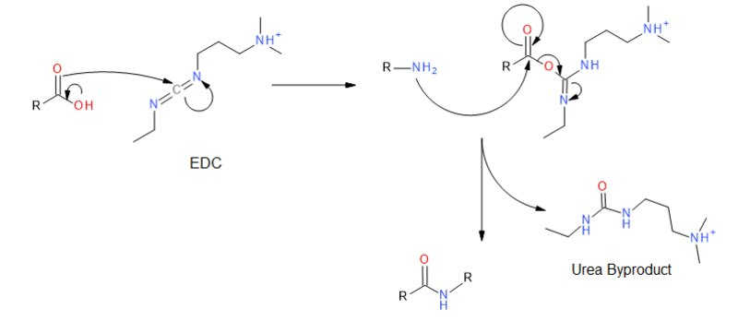
Immobilization Mechanism: Carbodiimide Crosslinker
1-(3-Dimethylaminopropyl)-3-ethylcarbodiimide hydrochloride
Mechanism of EDC-mediated coupling of carboxylic acids and amines
1,8-diaminooctane
Carboxylic acid
carboxyl groups (-COOH) on activated SU-8 surface
carboxylic spiropyran (SP-COOH)
EDC
Diamine
1, 8-diaminooctane
1, 4-diaminobutane

