Slide 1
Photoactuated Droplet Microfluidics Enabled via Spiropyrans
By Jamy Lee
PI: Dr. Vince Remcho

Slide 2
What does this mean?
Microfluidics: Device that uses small volumes
Photoactuated: Operates using light
Spiropyrans: photochromic molecules
Notes:
Microfluidics: a common example of Microfluidics is a pregnancy test or glucose test. Takes a small amount of liquid and using capillary action, moves liquid across a chip
Spiropyran is a molecule that changes shape based on the light source. In the open form spiropyran can appear as a pink to purple color. Not only do you see a color change, but also a physical change. The closed form is hydrophobic and the open form is hydrophilic. This change can take up to 2-5 minutes to happen. And it’s Reversible!
On the title slide was a chip that a previous PhD student, Dao, made. You can clearly see that under visible light is colorless and after UV exposure, the chip turns a dark purple color.

Slide 3
Why is this Important?
Chemistry in a test tube is not practical
Controls how much reagent and when reagents react
Notes:
We rely on microfluidic devices for common uses. They are portable and provide a qualitative measurement that is fast and easy.
Example of how a pregnancy test works. Using capillary action a small amount of reagent reacts with target compounds to produce a color.
Why spiropyran? Remember, that based on what light form is shined the physical properties of the chip itself can change. If we can control how hydrophobic or hydrophilic the area is, we can control how much and when the reagents will react

Slide 4
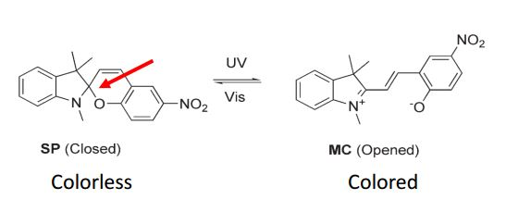
Why do we care?
Hydrophilic vs Hydrophobic within seconds
Inexpensive
No mechanical pump, a separation column, or detector
Regulate transport across membrane media
Notes:
Can change a surface from hydrophobic to hydrophilic
In Picture, the surface is a spiropyran integrated in a butyl methacrylate nanofiber mat on a glass slide mesh.

Slide 5
Goal
Control release of chemicals without altering device
Notes:
We can mechanically alter a device using just light. In picture is a very complicated and elaborate microfluidic device. Now what if we could control these individual channels and tell it when to allow liquid through?

Slide 6
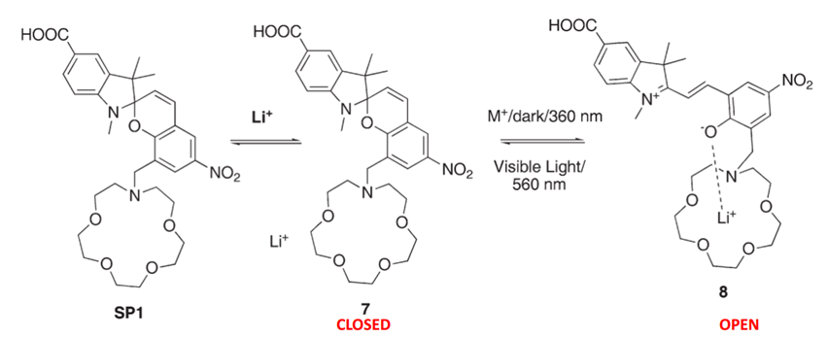
Background
Clean water
Captures Heavy Metals: Pb and Li
Notes:
Before we can jump into this project. We first need to understand what has already been done.
Previous PhD student, Dao, investigated how spiropyran can be used in heavy metal extraction. By adding a crown structure to the compound a slightly ionic bond can be made to trap metal ions from water. This method has also been tried in optical fibers, which are a long fiber that allows light to shine throughout.

Slide 7
Problem
Limit to the reversibility of reaction
Contact Angle Measurement:
Hydrophilic
Hydrophobic
Notes:
Unfortunately, this reaction has its limitations.
We use contact angle measurements to measure how quickly the surface can switch between the hydrophobic form vs the hydrophilic form

Slide 8
Problem
Notes:
When we map the contact degree after 1 minute VIS or UV, we see a gradual decrease in the change

Slide 9
Synthesis Step 1
1:1 ratio of 2,3,3-trimethylindolenine and methyl-4-bromobutyrate in chloroform
Reflux for 24 hours
Structure confirmed with Thin Layer Chromatography (TLC) and Nuclear Magnetic Resonance (NMR)

Slide 10
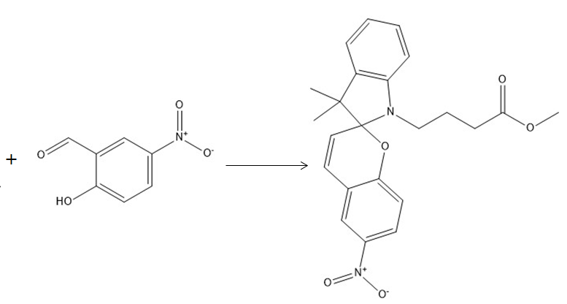
Synthesis Part 2
Product from step 1 was added dropwise to 2-hydroxy-5-nitrobenzaldehyde
Refluxed for 6 hours

Slide 11
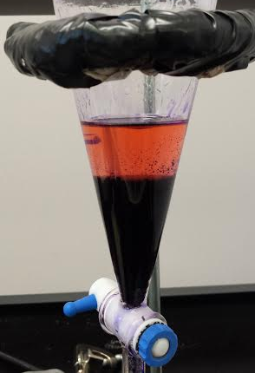
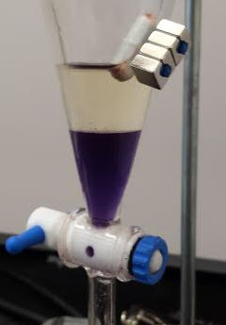
Synthesis Part 2
Product from reflux dissolved in Dichloromethane
Washed with 10% Aqueous sodium bicarbonate until aqueous layer is clear
Organic (blue) layer dried over Na₂SO₄

Slide 12
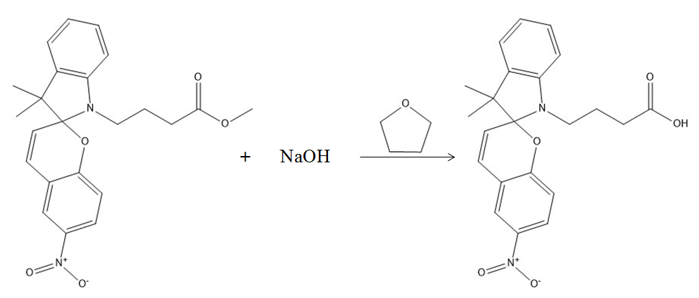
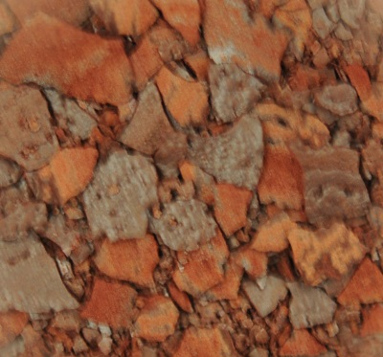
Synthesis Part 3
Product from Part 2 was added to Tetrahydrofuran (THF)
10% NaOH was added dropwise
Stirred for 24 hours
Reaction quenched with 10% Citric Acid Solution
Extracted with Chloroform

Slide 13
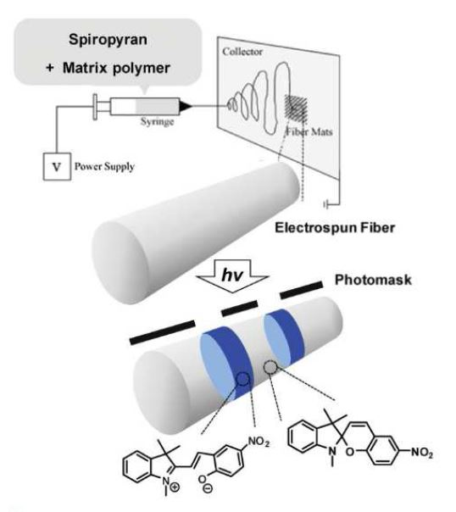
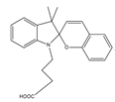
Spiropyran as a paper
Electrospun polymer microfibers
Polystyrene or polyethylene oxide
Irradiated for 20 - 30 seconds
Right:
A) Irradiation for 20 seconds and heated for 10 seconds
B) 10 cycles
C) 20 cycles
Open
Closed

Slide 14
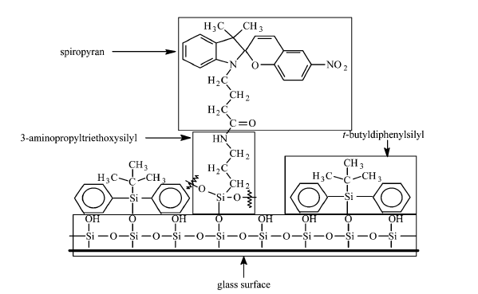
Functionalization on Glass Microfiber Paper
Application to a surface
Notes:
1-ethyl-3-(3-dimethylaminopropyl)carbodiimide (EDC) used as a carboxyl activating agent for the coupling of primary amines to yield amide bonds
APTES used to link spiropyran to glass surface
TBDS used as spacers to allow spiropyrans to open and close

Slide 15
Methods
Glass Microfiber Filter Papers
(Whatman A, Whatman B, Whatman D, Millipore)
Cleaned
(Methanol / HCl Solution)
Soaked in TBDS (spacer)
(0%, 0.1%, and 0.5% solution in Dry Toluene)
Soaked in ATES (linker)
(0%, 0.1%, and 0.5% solution in Dry Toluene)
Cured Time
(30, 60, 90, 120, and 180 minutes)
Soaked in Spiropyran/EDC
(30 and 60 minutes)

Slide 16
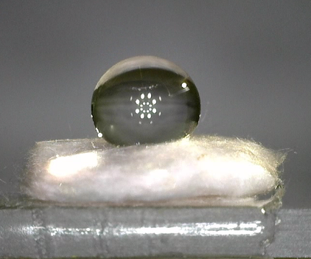
Results
Whatman GF/D Glass Microfiber Filter Paper
Incubated in 0.1% TBDS for 30 minutes
Incubated in 0.1% ATES for 30 minutes
Incubated in Spiropyran/EDC solution for 1 hour
UNDER VISIBLE LIGHT
AFTER 30 SEC UV EXPOSURE

Slide 17
Conclusion
Synthesize spiropyrans using a low cost method
Identify different medias to function
Functionalized different surfaces
Optimize the exposure parameters
Paved a path for practical application of optically gating surfaces

Slide 18
Future Steps
Optimize Reagent Concentrations and Incubation Time
Quantify Amount of Reagents on Surface using Thermogravimetric Analysis (TGA)
Test Different Types of Filter Papers and Surfaces
Apply on Larger Scale

Slide 19
Acknowledgements
Dr. Vince Remcho
Lindsey Sequeira
Leslie Loh
Remcho Research Group
Dr. Chris Beaudry and Jessica Vellucci
Dr. Kevin Ahern
SURE Science Award Funding

